Slide 1
The PCB structure of Unix & its queue discipline
张可
2017.03.09

Slide 2
01
Overview of PCB
02
Unix PCB structure
03
CONTENTS
Comparison
04
Details
05
Queue discipline
06
Reference & Quote

Slide 3
01
Overview of PCB

Slide 4
01
Overview of PCB
Process identification
Process Control Block
Processor state information
Process control information

Slide 5
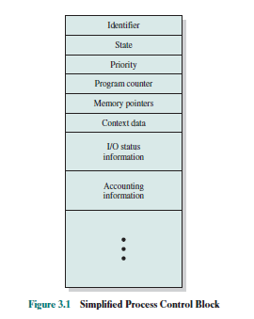
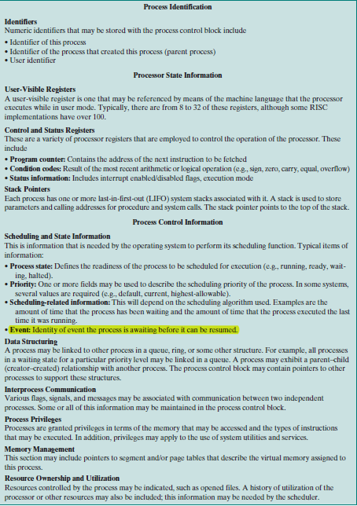
01
Overview of PCB

Slide 6
02
Unix process control lock

Slide 7
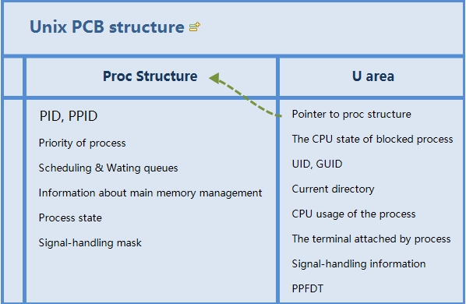
02
Unix process control lock
PID(Process Identification)
PPID(Parent’s PID)
UID(Unique Identification)
GUID(Global UID)

Slide 8
03
Comparison

Slide 9
03
Comparison

Slide 10
04
Details

Slide 11
Process creation
in UNIX
1.
It allocates a slot in the process table for the new process.
2.
It assigns a unique process ID to the child process.
3.
It makes a copy of the process image of the parent, with the exception of any shared memory.
4.
It increments counters for any files owned by the parent, to reflect that an additional process now also owns those files.
5.
It assigns the child process to the Ready to Run state.
6.
It returns the ID number of the child to the parent process, and a 0 value to the child process.

Slide 12
05
Queue discipline

Slide 13
05
主要结论
优先数调度算法
每一个进程都有一个p_pri
-127＜p_pri<127,
0 is the highest level.
调度/分派结构
调度：组织维护ready进程队列
分派：CPU free 使得ready queue首投入运行
队列结构
I/O waiting queue
Low priority ready queue
High priority ready queue
进程调度算法
CPU空闲时，
1.高有限就绪队列非空，从高优先就绪队列中选择一个进程执行；
2.高优先就绪队列为空，从低优先就绪队列中选择一个进程执行。
Queue

Slide 14
06
Reference and Quote

Slide 15
06
Reference and Quote
GOOD94 Goodheart, B., and Cox, J. The Magic Garden Explained: The Internals of
UNIX System V Release 4. Englewood Cliffs, NJ: Prentice Hall, 1994.
Syed Mansoor Sarwar, Robert M.Koretsky, UNIX, Third Edition: The Textbook,
@2017 by Taylor & Francis Group,LLC
William Stallings, Operating systems : internals and design principles — 7th ed.
http://www.unix.com/
http://dl.acm.org/
http://ieeexplore.ieee.org/Xplore/home.jsp

Slide 16
Thanks for listening！
张可
2017.03.09

